Slide 1
GIT – Version Control System
Part – 1 Introduction to GIT and Basic Commands
S. Yogesh Kumar
sykumar@tricoresolutions.com
Middleware Services – TriCore Solutions

Slide 2
Agenda
What is GIT?
Centralised Vs Distributed VCS
Architecture and Workflow of GIT
Advantages of GIT
Installation of GIT
Configuring GIT Environment
GIT Basics
Creating a GIT repositories
Recording changes to GIT repositories
Viewing the History
Undoing Things
Working with remote repositories
Tagging
Tips and Tricks

Slide 3
GIT – Version Control System
GIT is a Version Control System (VCS) that record changes to a file or set of files over time so that you can recall specific versions later.
It allows you to revert files or entire project back to a previous state,
Helps to maintain the source code of your project in well organised manner. Therefore also known as SCM
Compare changes over time
It allows you to see who made the changes, when and why, and many more…
The Version control systems can be of two types:
Centralised Version Control Systems (CVCS)
Distributed Version Control Systems (DVCS)

Slide 4
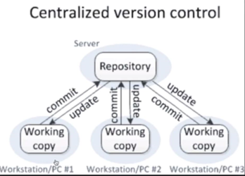
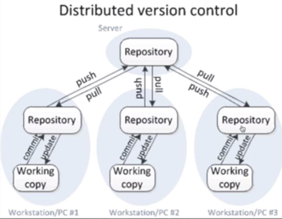
Centralised Vs Distributed Version Control Systems
These VCS has a single server that contains all the versioned files and a number of clients that check out files from central place.
The major downside of this setup is the Single Point of Failure - If the central server goes down for an hour, then during that hour nobody can collaborate at all or save versioned changes to anything they’re working on.
In this setup clients don’t just check out the latest snapshot of the files ; they fully mirror the remote repository.
Thus if remote server dies and these systems were collaborating via it, any of the client repositories can be copied back to the server to restore it. Every checkout is really a full backup of all the data .
GIT is a Distributed VCS.

Slide 5
Architecture and Workflow of GIT
Three tier architecture (The three stages of GIT)
Workflow
GIT Repository (Remote)
GIT Repository (Local)
Committed
GIT Commit Operation
PULL / CLONE
PUSH
Staging Area
Staged
GIT Repository (Local)
GIT Add Operation
GIT Commit Operation
Working Directory
Modified
Staging Area
Steps:
GIT Add Operation
You clone remote repository to local.
You modify files in your working directory.
Working Directory
You stage files, adding snapshots of them to the staging area.
You do a commit, which takes the files as they are in the staging area and
stores that snapshot to your Git repository.

Slide 6
Advantages of GIT
Free and open source
Fast and small
Implicit backup
Security
No need of powerful hardware
Easier branching

Slide 7
Installing GIT
Prerequisites:
curl, zlib, openssl, expat, and libiconv
$ yum install curl-devel expat-devel gettext-devel openssl-devel zlib-devel
Installing on linux
Debian/Ubuntu: $ apt-get install git
Fedora:
$ yum install git (up to Fedora 21)
$ dnf install git (Fedora 22 and later)zz
Installing from Source
Use wget command to install git version 2.7.2 from tarballs
First to install wget use command: $ yum install wget
After installing wget use command: $ wget https://www.kernel.org/pub/software/scm/git/git-2.7.2.tar.gz
Unzips the tar file using command: $ tar –zxf git-2.7.2.tar.gz
Change current directory to git: $ cd git-2.7.2
Configure for local user: $ ./configure --prefix=/usr/local
Install git using command: $ make install

Slide 8
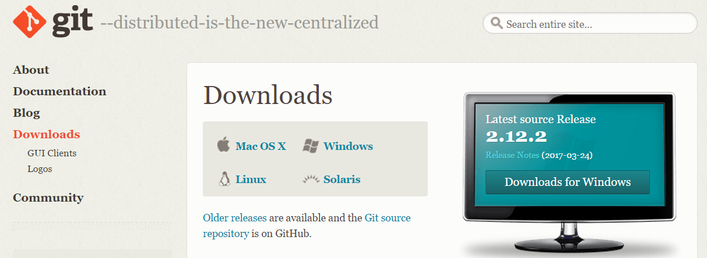
Installing GIT
Installing on windows
Go to url: https://git-scm.com/download
Download the installer an run. It will install the mentioned version of the git.

Slide 9
First-Time Git Setup
git config: tool that lets you get and set configuration variables that controls all aspects of how git looks and operate.
GIT config command:
git config –list #Outputs all config values
git config –system –list #Output config values for every users on the system and all their repositories
git config –global –list #Output config values for specific users
.git/config in the git directory contains config values specific to that repository.
Your Identity
$ git config --global user.name “S Yogesh Kumar” # Sets user name
$ git config --global user.email sykumar@tricoresolutions.com # Sets user email

Slide 10
First-Time Git Setup
Your Editor
$ git config --global core.editor “C:\Program Files (x86)\Notepad++\notepad++.exe” # Sets your editor
Your Diff Tool
$ git config --global merge.tool vimdiff # Sets your Diff Tool
Checking Your Settings
$ git config --list # Displays a list of all settings

Slide 11
GIT Basics
1.1 Getting the GIT Repository
Initialising a Repository
Use: $ git init command to initialize a new GIT Repository.
Cloning an Existing Repository
To clone an existing repository from a remote location:
$ git clone [url] E.g.: $ git clone https://github.com/sykumar/git_demo
$ git clone [url] [folder_name ] E.g.: $ git clone git://github.com/schacon/grit.git my_newfolder

Slide 12
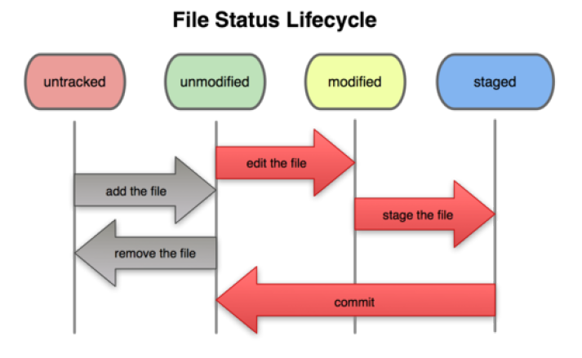
GIT Basics
1.2 Recording Changes to the Repositories
File Status Life Cycle:
Untracked File: File not present in current git snapshot
Tracked File: File present in current git snapshot
Unmodified: file not modified after commit and git repository has the up to date tracking information.
Modified: File modified after last commit but not added to the staging area.
Staged: File added to the staging area after modification.
Checking the status of your files
To check the status use the command: $ git status

Slide 13
GIT Basics
Tracking new files:
Add the file to staging area using command: $ git add [file_name]
Staging Modified Files:
Use Add command to stage the modified files:
$ git add [file_name] #This command adds a mentioned file to the staging area
$ git add [directory_path] #This command add all the modified files in the mentioned directory recursively
$ git add . #This command adds all the modified files including those in subdirectories to the staging area
Ignoring Files
.gitignore file contains
The rules for the patterns you can put in the .gitignore file are as follows
Blank lines or lines starting with # are ignored
Standard glob patterns work
You can end patterns with a forward slash (/) to specify a directory
You can negate a pattern by starting it with an exclamation point (!).

Slide 14
GIT Basics
Viewing Staged and Unstaged Changes
Use $ git diff command to see what you changed in the files:
Generally used to see what have you changed but not added to staging area.
And to see what you have staged that you are about to commit
$ git diff #Gives you the difference in the files you have modified but not staged.
$ git diff --staged or $ git diff --cached # Gives you the difference for the files you have staged.
Committing your changes
To commit any changes you need to do the following
Create a new file in the repository
Add the file to the staging area using command:
$ git add <filename> , or $ git add [directory_path], or $ git add . #Adds the files to the staging area
Now commit the changes by using the command:
$ git commit #This command open up your default editor for commit message
$ git commit -m “Your Commit Message” #This command commits the changes with the mentioned message
$ git commit -a -m “message” #This command adds the file to staging area and then commit changes

Slide 15
GIT Basics
Removing Files
If you remove files using rm command; the changes will not be staged to the staging are
If you use $ git rm command; it will remove the file from working directory as well stage the changes so that you can commit.
$ rm [file_name] #Linux command to delete the file and do not adds the changes to staging area
$ git rm [file_name] #GIT command to delete the and adds the changes to staging area
$ git rm [file_name] –f #GIT command to force remove the file which is present in staging area
$ git rm [directory_path]/*.txt #GIT command to remove all the txt files from the mentioned directory

Slide 16
GIT Basics
1.3 Viewing the Commit History
You can use the log command to view the commit history
$ git log
Many options can be used along with the log command to customize the output
$ git log –p or $ git log –p –2 #Shows the patch introduced with each commit
$ git log --stat #Shows statistics of each file modified in each commit
$ git log --pretty=oneline #Shows log in one single line
git log --pretty=format:"%h - %an, %ar : %s” #Format the output of the log command

Slide 17
GIT Basics
Viewing the Commit History
Here is the list of the format options that can be used along with the git log command.
Option | Description of output
%H | Commit Hash
%h | Abbreviated commit hash
%T | Tree Hash
%t | Abbreviated tree hash
%P | Parent hashes
%p | Abbreviated parent hashes
%an | Author name
%ae | Author email
%ad | Author date
%ar | Author date (relative)
%cn | Committer name
%ce | Committer email
%cd | Committer date
%cr | Committer date (relative)
%s | Subject

Slide 18
GIT Basics
Viewing the Commit History
To change the output of the log command you can use the following option
Option | Description of output
-p | Show the patch introduced with each commit
- -stat | Show statistics for files modified in each commit
- -shortstat | Display only the changed/insertions/deletions line from the --stat command.
- -name-only | Show the list of files modified after the commit information
- -name-status | Show the list of files affected with added/modified/deleted information as well
- -abbrev-commit | Show only the first few characters of the SHA-1 checksum instead of all 40
- -relative-date | Display the date in a relative format (for example, “2 weeks ago”) instead of using the full date format.
- - graph | Display an ASCII graph of the branch and merge history beside the log output
- -pretty | Show commits in an alternate format. Options include oneline, short, full, fuller, and format (where you specify your own format).

Slide 19
GIT Basics
Limiting Log Output
You can limit the number of commits in the log output
E.g. $ git log --since=2.weeks
E.g.: $ git log --pretty="%h - %s" --since="2017-04-29" --before="2017-05-03“
Using a GUI to Visualize History
Use command $ gitk to visualize the commit history
Option | Description of output
-(n) | Shows only the last n outputs
- - since, - -after | Limits the commits to those made after the specified dates
- -until, - - before | Limit the commits to those made before the specified date.
- -author | Only show commits in which the author entry matches the specified string.
- -committer | Only show commits in which the committer entry matches the specified string.

Slide 20
GIT Basics
1.4 Undoing Things
Changing your last commit
Use $ git commit --amend # this command takes your staging area and uses for the commit
Unstaging a Staged File
Use $ git reset HEAD <file> # this command moves the file from staging to modified state.
Unmodifying a Modified File
Use $ git checkout - - <file> # this command revert backs the changes you have done in the file

Slide 21
GIT Basics
1.5 Working with Remote
Showing your Remotes
$ git remote # This command shows the short name of your remote GIT repository
$ git remote –v # This command shows the complete URL of your remote GIT repository
Adding Remote Repositories
$ git remote add [short name] [url] # This command adds a remote repository.
Fetching and Pulling from your Remote
Use $ git fetch [remote-name] # This command gets you all the data that you don’t have from the mentioned remote repository
$ git pull [remote-name] # This command is same as fetch. The difference between the two is that fetch command does not merge remote data with your local repository data. You have to manually merge the data that you have fetched. On the other hand pull command automatically merges the data.
Pushing to your Remote
Use $ git push [remote-name] [branch name] # This command push the data you have committed on you local repository to the remote.

Slide 22
GIT Basics
Inspecting a Remote
$ git reote show [remomte-name] # This command lists the URL for the remote repository as well as the tracking branch information
$ git remote –v # This command shows the complete URL of your remote GIT repository
Removing and Renaming Remote
$ git remote rename [old-short-name] [new-short-name] # This command changes the short name of your remote repository.
$ git remote rm [shrt-name] # This command removes the remote directory reference.

Slide 23
GIT Basics
1.6 Tagging
Tags are used to mark specific points in history as being important. Generally tags are used to mark release point (v1.0, 1.2 and so on)
Listing your Tags
$ git tag # This command lists the tag in the alphabetical order.
$ git tag –l ‘v1.0.*’ #This command list the specific tags according to search pattern.
Creating Tags
GIT uses two types of tags: Lightweight and Annotated.
Lightweight tag is just a pointer to a specific commit. They do not contain any information.
Annotated tags are stored as full object in GIT database. They are checksummed; contains the tagger name, email and date; have tagging message; and can be signed and verified with GNU Privacy Guard (GPG)

Slide 24
GIT Basics
Annotated Tags
$ git tag –a v1.4 –m “my version 1.4” # This command creates an annotated tag of v1.4 with a tagging message.
$ git show v1.4 # This command displays the information about the tag.
Signed Tags
git tag -s v1.5 -m 'my signed 1.5 tag'# This command creates a signed tag of v1.4 with a tagging message.
Lightweight Tags
$ git tag v1.3 #This command adds a light weighted tag to the latest commit.
Verifying Tags
$ git tag –v v1.3 #This command uses GPG to verify signature. You need the signer’s public key in your keyring for this to work properly.

Slide 25
GIT Basics
Tagging Later
You can also tag commits after you’ve moved past them.
$ git tag –a v1.2 [checksum] #This command adds an annotated tag v1.2 to the commit specified by the mentioned checksum
Sharing Tags
By default, the git push command doesn’t transfer tags to remote servers. You will have to explicitly push tags to a shared server after you have created them.
$ git push [remote-name] [tag-name] #This command pushes the mentioned tag to the mentioned remote repository
$ git push [remote-name] --tags #This command pushes all tags present in the local repository to the mentioned remote repository.

Slide 26
GIT Basics
1.7 Tips and Tricks
Auto-Completion
Copy git-completion.bash file from contrib/completion directory in GIT source code and paste in the below directory:
/opt/local/etc/bash_completion.d Directory on MAC systems
/etc/bash_completion.d/ on Linux system
Once you copied the bash file, enter tab to autocomplete command
E.g.: $ git co<tab><tab> #This will show you the command options or autocomplete it.
GIT Aliases
If you don’t want to type the entire text of each of the Git commands, you can easily set up an alias for each command using git config
$ git config --global alias.co checkout #Alias for checkout command
$ git config --global alias.ci commit #Alias for commit commad

Slide 27
Thank you!

